Slide 1
CS305
System Modeling and Simulation
Prof. Dr. Khaled Mahar
khmahar@aast.edu
Lecture 6

Slide 2
Introduction To Arena

Slide 3
1 - ARENA DISCRETE EVENT SIMULATION SOFTWARE
The Arena modeling system is a flexible and powerful tool that allows analysts to create animated simulation models that accurately represent virtually any system.
Simulation analysts place graphical objects—called modules—on a layout in order to define system components such as machines, operators, and material handling devices.
In Arena, modules are the flowchart and data objects that define the process to be
simulated. All information required to simulate a process is stored in modules.

Slide 4
2 - THE CORE OF THE SOFTWARE
The core technology of Arena is the SIMAN simulation language.
Arena is a Microsoft® Windows® compliant product. The entire product is written in object-oriented Visual C++™. This allows users to leverage Microsoft’s open architecture to integrate external data and applications with Arena models.
Other possible connections: Microsoft Office, ActiveX, ODBC, Visual Basic.

Slide 5
3 - FLOWCHART MODEL DEVELOPMENT
Arena was designed to make creating simulation models an entirely graphical process. All system behaviors are represented by using graphical modules. For system logic such as IF/THEN/ELSE-type branching and queue selection rules, the user creates a flowchart of his system by placing the appropriate graphical modules on the Arena layout and directly connecting these modules.
Model – Simulate – Visualize - Analyze
Before opening the program (which will approximately happen in Slide 10), let us speak about SOME components: entities, resources, queues, variables, processes.
Notes:
There are 5 components in the model

Slide 6
3.1 - Entities
Entities are dynamic elements that pass through the system.
Entities are distinguished by their attributes.
Entities must be created to get them into the module and are disposed when they leave.
Attributes must be numerical values.
As we build the flowchart, it’s helpful to think of the process from the perspective of the entity. The trigger for an action to be accomplished is the arrival of an entity.

Slide 7
3.2 - Resources
Resources have a name and a capacity (number of identical units of the resource).
Resources may have a schedule (how many of them are available and when).
Resources are automatically defined by some modules (e.g., Process).

Slide 8
3.3 - Queues
Entities queue when they need processing
An entity tries to seize a resource.
The time the entity uses the resource is the delay.
If the resource is not available, the entity waits in a queue.
The entity releases the resource when processing is complete.

Slide 9
3.4 - Variables
Arena allows the user to work with simulation variables. They contain information about particular dimensions of the model.
Many of them are built-in.
Time Attribute Variables, Cost Attribute Variables…
Variables can be referenced in modules, can be reassigned a new value with a particular module, and can be used in any expression.

Slide 10
3.5 - Processes
Entity must be processed.
This activity is performed by one or more resources and requires some time to complete.

Slide 11
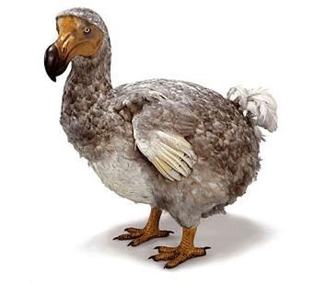


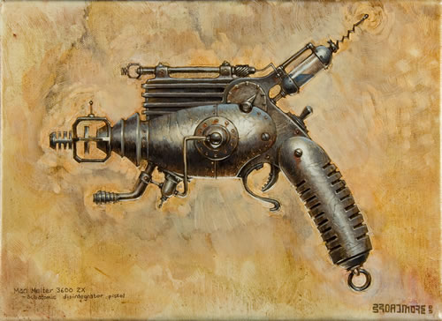
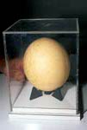
3.6 – Until Now
An Entity Generator…
The Output
…And The Resource
…Its Queue…
A Process…
…The Entity

Slide 12
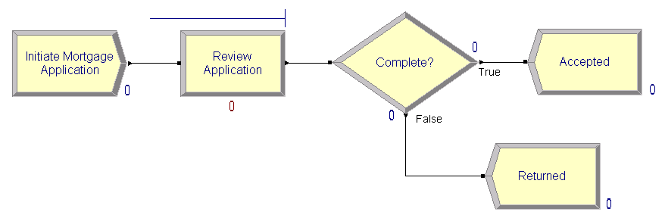
Analyze a home mortgage application process
look at the process of receiving and reviewing a home mortgage application, We will build the flowchart shown below

Slide 13
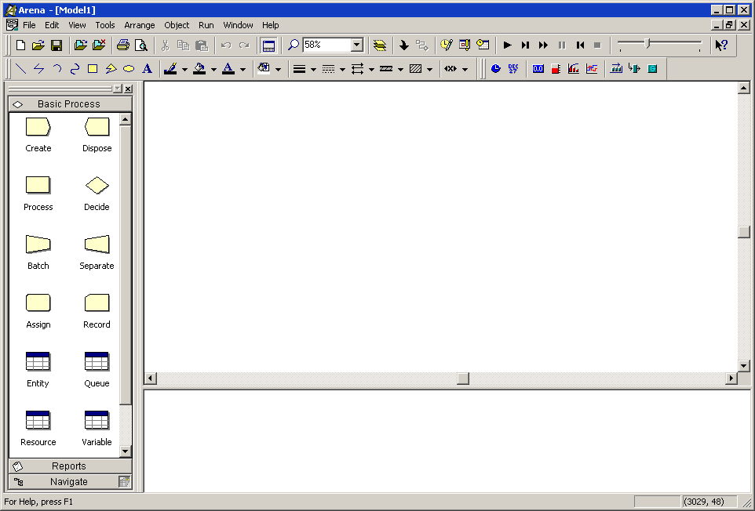
The Arena modeling environment
Programs > Rockwell Software > Arena
Project Bar
Model window
flowchart view
Model window
spreadsheet view
Notes:
To model your process in Arena, you’ll work in three main regions of the application
window. The Project Bar hosts panels with the primary types of objects that you will work
with:
􀂄 Basic Process, Advanced Process, and Advanced Transfer panels: Contain the
modeling shapes, called modules, that you’ll use to define your process.
􀂄 Reports panel: Contains the reports that are available for displaying results of simulation
runs.
􀂄 Navigate panel: Allows you to display different views of your model, including
navigating through hierarchical submodels and displaying a model thumbnail view.
In the model window, there are two main regions. The flowchart view will contain all of your model graphics, including the process flowchart, animation, and other drawing elements. The lower, spreadsheet view displays model data, such as times, costs, and other parameters.

Slide 14
Map your process in a flowchart
Build a flowchart. The word itself— flowchart—suggests two of the main concepts behind modeling and simulation. We’ll be building a chart—also referred to as a process map or a model—that describes a flow. This raises a key question in process modeling: What exactly is it that will flow through the chart?
As we build the flowchart, it’s helpful to think of the process from the perspective of the entity (the mortgage application), asking questions like:
Where do the mortgage applications enter the process?
What happens to them at each step?
What resources are needed to complete work?
Notes:
This raises a key question in process modeling: What exactly is it that will flow through
the chart?
We’re modeling the process of reviewing mortgage applications. These mortgage applications
are the items, referred to as entities, that will move through the process steps in our model. They are the data, whether on paper or in electronic form, that are associated with our client’s request for a mortgage.

Slide 15
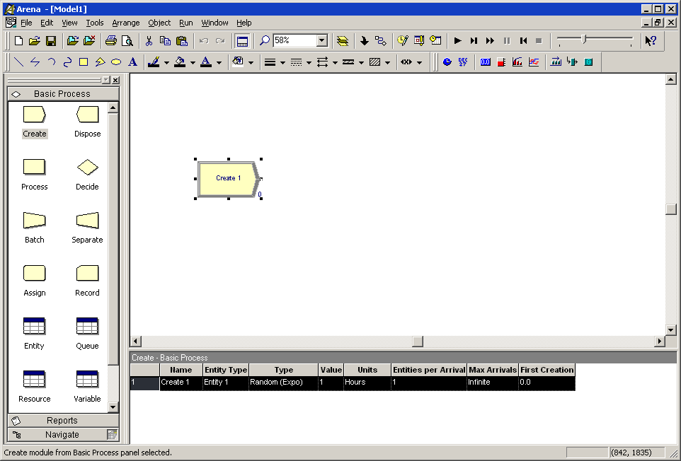
Create the mortgage application entities
Drag the Create module from the Basic Process
panel into the model window.
Every process flow
starts with a
Create module.
When you simulate
the flowchart,
individual entities
will be created
according to timing
information you
supply in the
Create module
properties. After it’s
created, each entity
moves from the
Create module to
the next shape in
the process flow.
Notes:
A default name, Create 1, is given to the module when it’s placed. We’ll return later to provide a more meaningful description as well as some data to support the simulation.

Slide 16
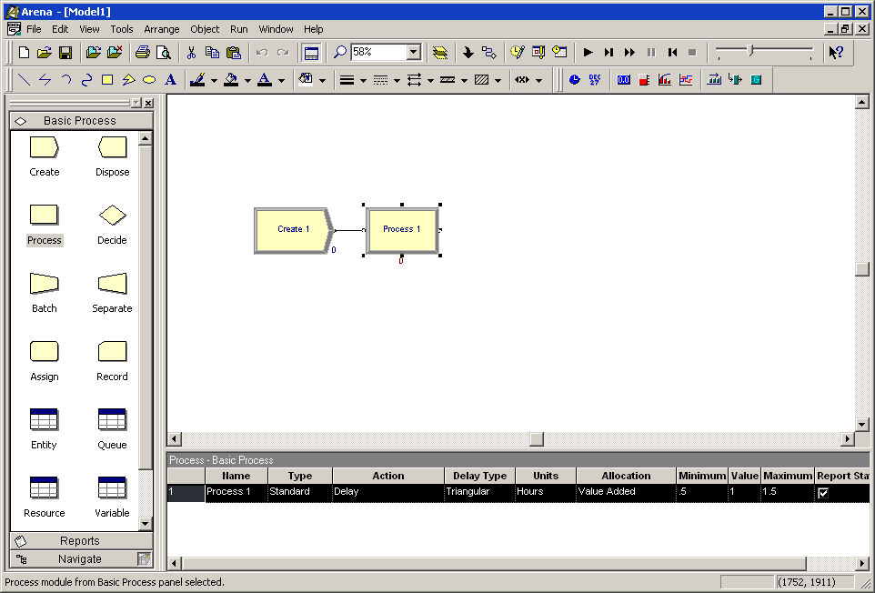
Process the applications
Drag a Process module from the Basic Process panel into the model window, placing
it to the right of the Create. Arena will automatically connect the two modules.
If your Create and
Process weren’t
connected automatically
when you
placed the Process,
check the Object >
Auto-Connect menu
to verify that it’s
checked. If it’s not,
select it to turn on
this option.
Notes:
Note: If no connection appears between Create and Process, click the Object > Connect menu item or the Connect toolbar button to draw a connection. Your cursor will change to a cross hair. Start the connection by clicking the exit point ( ) of the Create module, then click the entry point
( ) of the Process module to complete the connection. If you need to make multiple connections, simply double-click the Connect button or select Object > Connect twice (the Connect button will remain depressed to indicate it is in multi-connect mode). Then draw as many connections as desired. A valid connection target (e.g., entry point, exit point, or operand object) is now highlighted during a connection session if the pointer is hovered over it. To end the multi-connection session, click again on the Connect option, press Esc, or right-click.

Slide 17
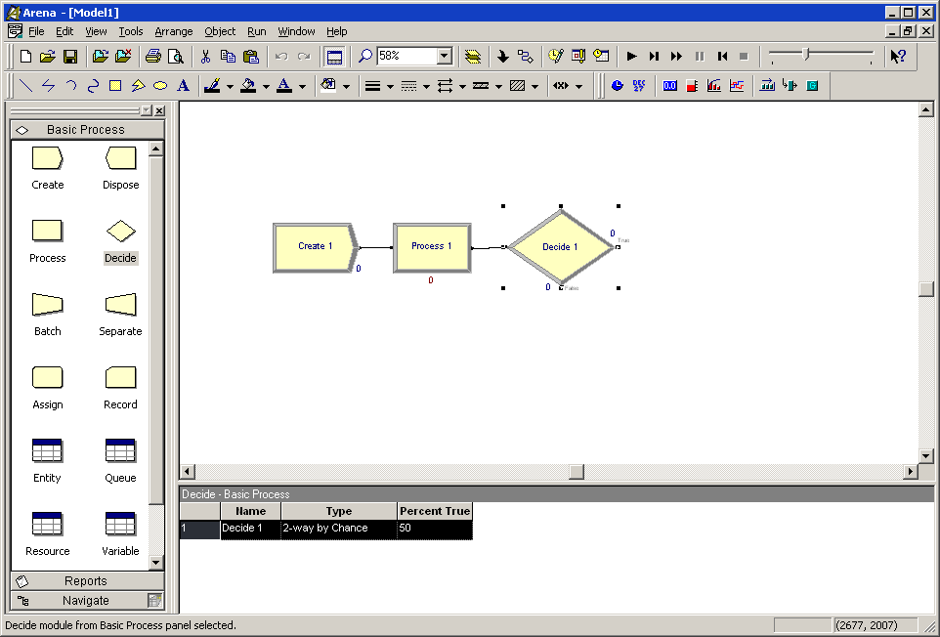
Decide whether applications are complete
Drag a Decide module to the right of the Process module.

Slide 18
Dispose the applications to terminate the process
Next we’ll place the Dispose module, from the Basic Process panel, representing accepted applications, connecting to the True (right) output from the Decide shape. Then, we’ll complete the flowchart with another Dispose for returned applications.
1. Select the Decide shape so that our first Dispose will be connected automatically.
2. Drag a Dispose module to the right of the Decide module. Arena will connect it to the primary (True) exit point of the Decide module.
3. To add the second Dispose module, once again select the Decide module, so that Arena will automatically connect its False exit point to the new Dispose module.
4. Drag and drop another Dispose module, placing it below and to the right of the Decide shape, completing the process flowchart.

Slide 19
What is a module?
In Arena, modules are the flowchart and data objects that define the process to be simulated. All information required to simulate a process is stored in modules.
Create: The start of process flow. Entities enter the simulation here.
Dispose: The end of process flow. Entities are removed from the simulation here.
Process: An activity, usually performed by one or more resources and requiring some time to complete.
Decide: A branch in process flow. Only one branch is taken.
Batch: Collect a number of entities before they can continue processing.
Separate: Duplicate entities for concurrent or parallel processing, or separating a previously established batch of entities.
Assign: Change the value of some parameter (during the simulation), such as the entity’s type or a model variable.
Record: Collect a statistic, such as an entity count or cycle time.
Simulation settings are defined in the Run > Setup > Replication Parameters dialog
box. There is also a set of data modules for defining the characteristics of various process elements, such as resources and queues.

Slide 20



Initiate mortgage application (Create module)
1. Double-click the Create module to open its property dialog box.
2. In the Name field, type Initiate Mortgage Application.
3. For the Entity Type, name our entities by typing Application.
4. Type 2 in the Value field of the Time Between Arrivals section.
Average of 2 hours between applicants
5. Click OK to close the dialog box.
Notes:
What are entities?
Entities are the items—customers, documents, parts—that are being served, produced, or otherwise acted on by your process. In business processes, they often are documents or electronic records (checks, contracts, applications, purchase orders). In service systems, entities usually are people (the customers being served in a restaurant, hospital, airport, etc.). Manufacturing models typically have some kind of part running
through the process, whether it’s raw material, a subcomponent, or finished product. Other models might have different types of entities, such as data packets in network analysis or letters and boxes in package-handling facilities.

Slide 21
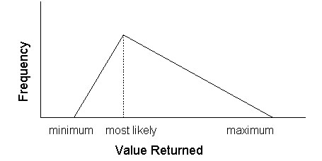


Review application (Process module)
The application will be reviewed for completeness by a Mortgage Review Clerk.
For work done by people or equipment, a triangular distribution provides a good approximation.
1. Double-click the Process module to open its property dialog box.
2. In the Name field, type Review Application
3. To define a resource to perform this process, pull down the Action list and select Seize Delay Release.
Notes:
Because this will take some amount of time, holding the entity at this point in the flowchart for a delay and requiring a resource to perform the activity, we use a Process module. We’ll call this process Review Application.
we also want to capture the natural variability that exists in most
processes. Very often, for work done by people or equipment, a triangular distribution
provides a good approximation. You specify the minimum time in which the work could
be done, the most likely value for the time delay, and the maximum duration of the process.

Slide 22


Review application (Process module)
4. A list of resources will appear in the center of the dialog box. To add a resource for
this process, click Add.
5. In the Resource Name field of the Resource dialog box, type Mortgage Review
Clerk.
6. Click OK to close the Resource dialog box.
7. Define the process delay parameters in the Minimum, Most Likely Value, and Maximum fields as 1, 1.75, and 3. (Note that the default delay type is Triangular and the default time units are in hours.)
8. Click OK to close the dialog box

Slide 23


Complete? (Decide module)
After the mortgage application has been reviewed, we determine whether to accept or
return the application. Assume 88% of applications accepted as complete.
1. Double-click the Decide module to open its property dialog box.
2. In the Name field, type Complete?.
3. For the Percent True field, type 88
4. Click OK to close the dialog box.

Slide 24


Accepted, Returned (Dispose module)
Because there are two possible outcomes of the mortgage application process—applications can be accepted or returned—we’re using two Dispose modules that will count the number of applications under each outcome.
1. Double-click the first Dispose module (connected to the True condition branch of the
Decide module) to open its property dialog box, and in the Name field, type
Accepted.
2. Click OK to close the dialog box.
3. Double-click the other Dispose module to open its property dialog box. In the Name
field, type Returned.
4. Click OK to close the dialog box.

Slide 25
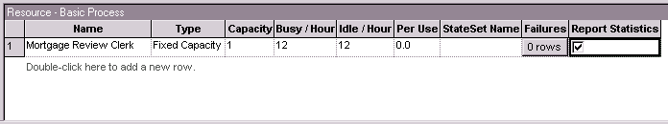
Mortgage review clerk (Resource module)
define the cost rate for the Mortgage Review Clerk so that simulation results
reports the cost associated with performing this process. The clerk’s costs are fixed at
$12 per hour.
1. In the Basic Process panel, click the Resource icon to display the Resources spreadsheet.
2. Because we defined the Mortgage Review Clerk as the resource in the Review
Application process, Arena has automatically added a resource with this name in the
Resources spreadsheet.
Click in the Busy/Hour cell and define the cost rate when the clerk is busy by typing 12.
Click in the Idle/Hour cell and assign the idle cost rate by typing 12.

Slide 26
Prepare for the simulation
To make the model ready for simulation, we’ll specify general project information and the duration of the simulation run. Since we’re just testing our first-cut model, we’ll perform a short, 20-day run.
1. Open the Project Parameters dialog box by using the Run > Setup menu item and clicking the Project Parameters tab. In the Project Title field, type Mortgage
Review Analysis; we’ll leave the Statistics Collection check boxes as the defaults, with Entities, Queues, Resources, and Processes checked and also check the costing box.
2. Next, click the Replication Parameters tab within the same Run Setup dialog box. In he Replication Length field, type 20; and in the Time Units field directly to the right of Replication Length, select days from the drop-down list. Click OK to close the dialog box.

Slide 27
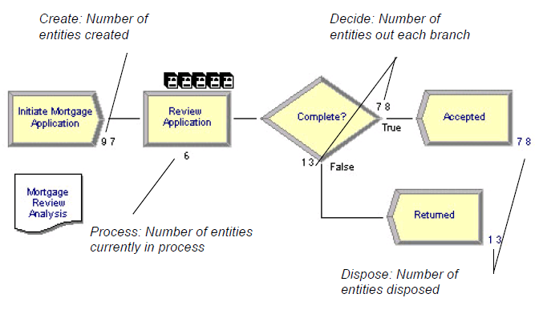
Simulate the process
Start the simulation run by clicking the Go button or clicking the Run > Go menu item.
As the simulation progresses, you’ll see small entity pictures resembling pages moving among the flowchart shapes. Also, a variety of variables change values as entities are created and processed.

Slide 28
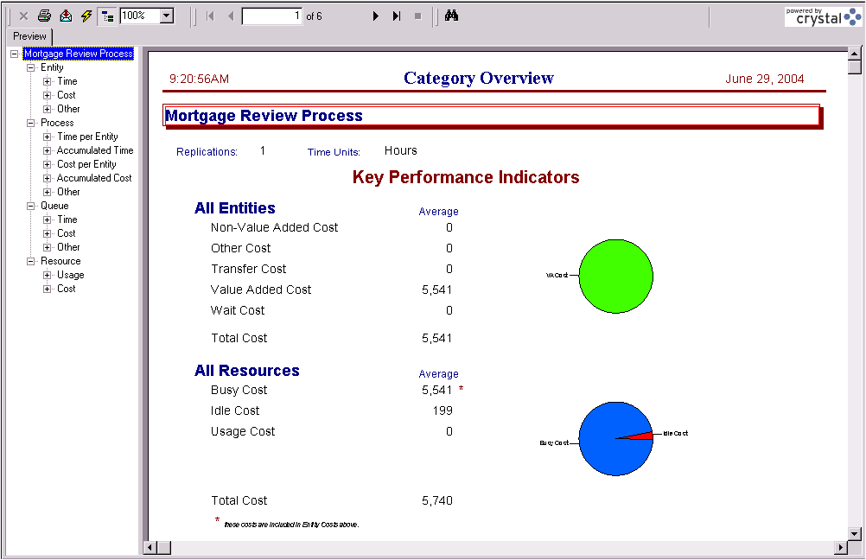
View simulation reports
At the end of the run, Arena will ask whether you’d like to view reports. Click Yes, and
the default report (the Category Overview Report) will be displayed in a report window.

Slide 29
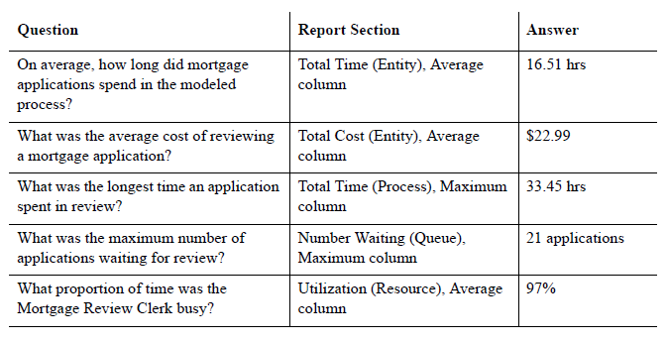
View simulation reports
The following table illustrates some of the questions you could answer from the Category Overview Report on our simple mortgage application process simulation.
After you’ve browsed the Category Overview Report, you can close it by clicking on the
window icon to the left of the File menu and clicking Close.

